Slide 1
Building Your First App with Spring Boot and Angular
CREATING THE SPRING BOOT PROJECT

Slide 2
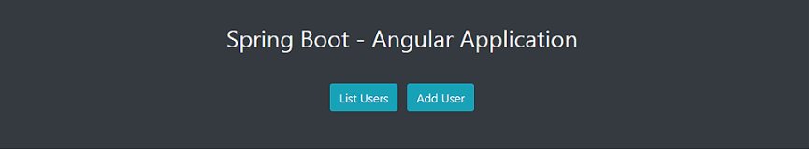

Slide 3
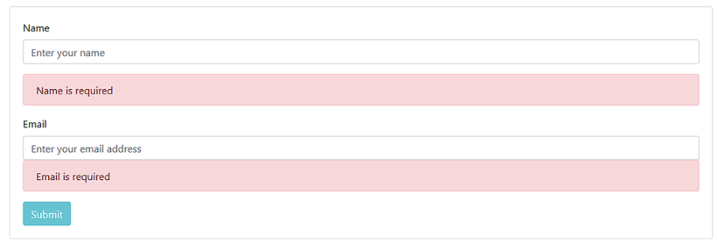

Slide 4
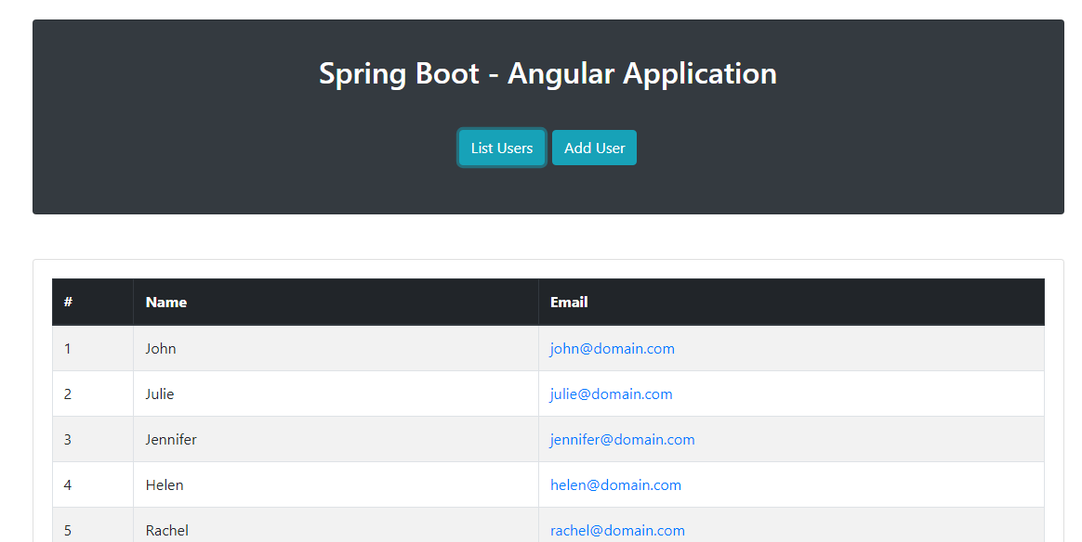

Slide 5
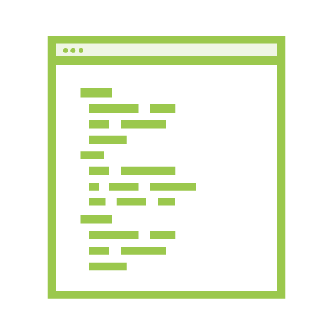
Course Overview and Expectations
Creating Your First Spring Boot Application
Angular 11
JPA, Spring Data JPA, Java, REST,
Web Components, Angular Routing, etc.

Slide 6

Spring Boot Prerequisites
•
•
•
•
Java 1.9+
Maven 3+
(http://www.oracle.com/technetwork/java/javase/downloads/index.html) (https://maven.apache.org/)
Spring Tool Suite (https://spring.io/tools/sts/all) Postman (https://www.getpostman.com/)

Slide 7
Summary
Created an app at https://start.spring.io
Added a POJO model Created a @RestController

